Slide 1

Well control incident
Location: <Location>
Rig type: <Rig type>
Well type: <Well type>
Date: <Date>
Well control incident category: ………………………………………
Level 1
Level 2
Level 3
Level 4
Impact: Lost time, HC release, etc…:
Plan:
  Description of plan……
Illustration / Wellbore schematic:
Operation with course of events:
  Event description……
Reason for events:
Free text evaluation
Lessons Learned:
Free text evaluation
Recommended actions:
Free text evaluation
Page 1 of 2

Slide 2
Well control incident
Location: <Location>
Rig type: <Rig type>
Well type: <Well type>
Date: <Date>
Critical Issues:
Free text evaluation
Direct Cause: |  | Underlying Cause:
 | Prognosis incorrect |  | Risk accepted
 | Mud weight selection |  | Error in program / procedure
 | Shallow gas |  | Procedure not followed
 | Shallow water flow |  | Lack of competence
 | Mud properties outside specification |  | Communication error (missing, wrong, incomplete, etc.)
 | Swabbing |  | Incorrect use of equipment
 | Ballooning |  | Equipment failure
 | HC accumulation below barrier element |  | BOP failure
 | Surface pressure control system failure |  | Other: ……………………………………………………………………
 | Downhole mechanical barrier failure
 | Downhole cement / casing barrier failure
 | Other: ……………………………………………………………………
Page 2 of 2

Slide 3
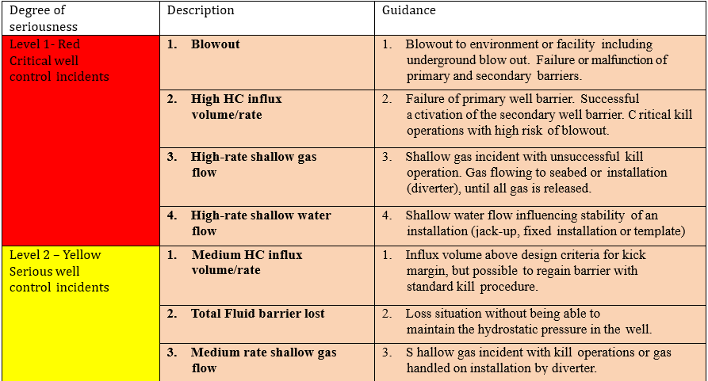

Categorisation and classification matrix for well control incidents
Drilling and Completion operations

Slide 4
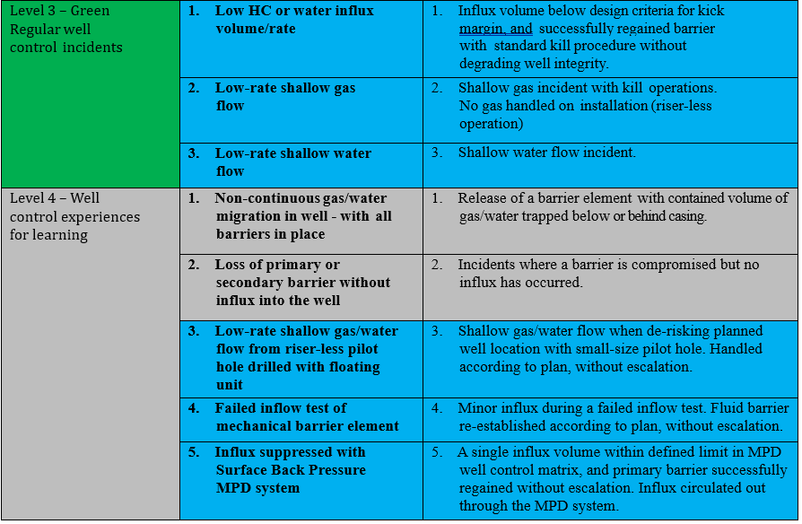
Categorisation and classification matrix for well control incidents
Drilling and Completion operations
Tan = Alert to PSA according to management regulation
Blue = Notification to PSA according to management regulation
Grey = Alert or Notification to PSA not required
Form: Confirmation of alert/notification to Petroleum Safety Authority

Slide 5
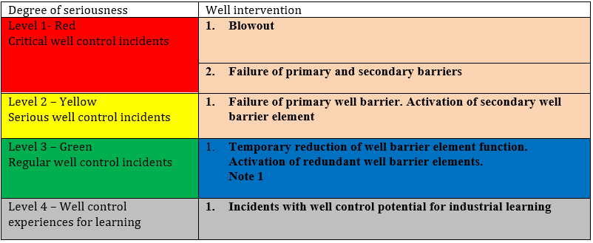
Categorisation and classification matrix for well control incidents
Well intervention operations

