Slide 1

Well Integrity incident
Incident category
Level 1 | Level 2 | Level 3 | Level 4
Location |  | Main issue | Select from table
Well type | Producer/injector etc. | Issue keywords | Select from table
Installation | Subsea/Platform |  | Select from table
Date | Feb.2021 |  | Select from table
Illustration/well bore schematic
Background:
Include important elements in detection and immediate assessments/actions
Include any other relevant integrity issues
Well integrity assessment conclusion:
What were the immediate and root causes from the investigation?
Were there other relevant problems identified?
117 reporting code
Mitigating actions / well risk:
Key mitigating long term actions
Lessons learned / operational adjustments:
Any important lessons learned or operational adjustments on the installation/field due to failure

Slide 2
Main issue | Issue keyword
Valve failure | ASV | DHSV
External leak | XT | WH
Tubing leak | Seals | Packer
Annulus leak | GLV | Testing
Overpressure | Monitoring | Hydraulics
Other | Corrosion | Erosion
 | Temperature | Burst
 | Control Line | Collapse
 | Cement | Formation
 | Fatigue | Lifetime
 | Maloperation | Compatibility
 | Instrumentation

Slide 3
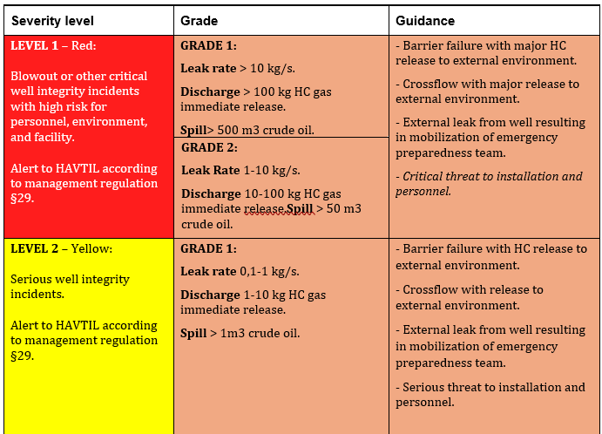
Matrix for categorization and classification of well integrity incidents For wells in operation / production

Slide 4
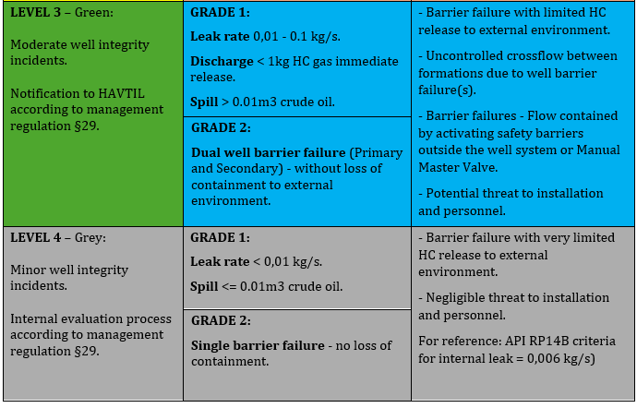
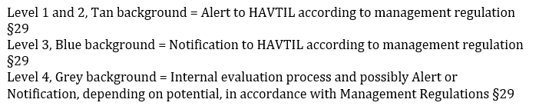
Matrix for categorization and classification of well integrity incidents For wells in operation / production

