Slide 1
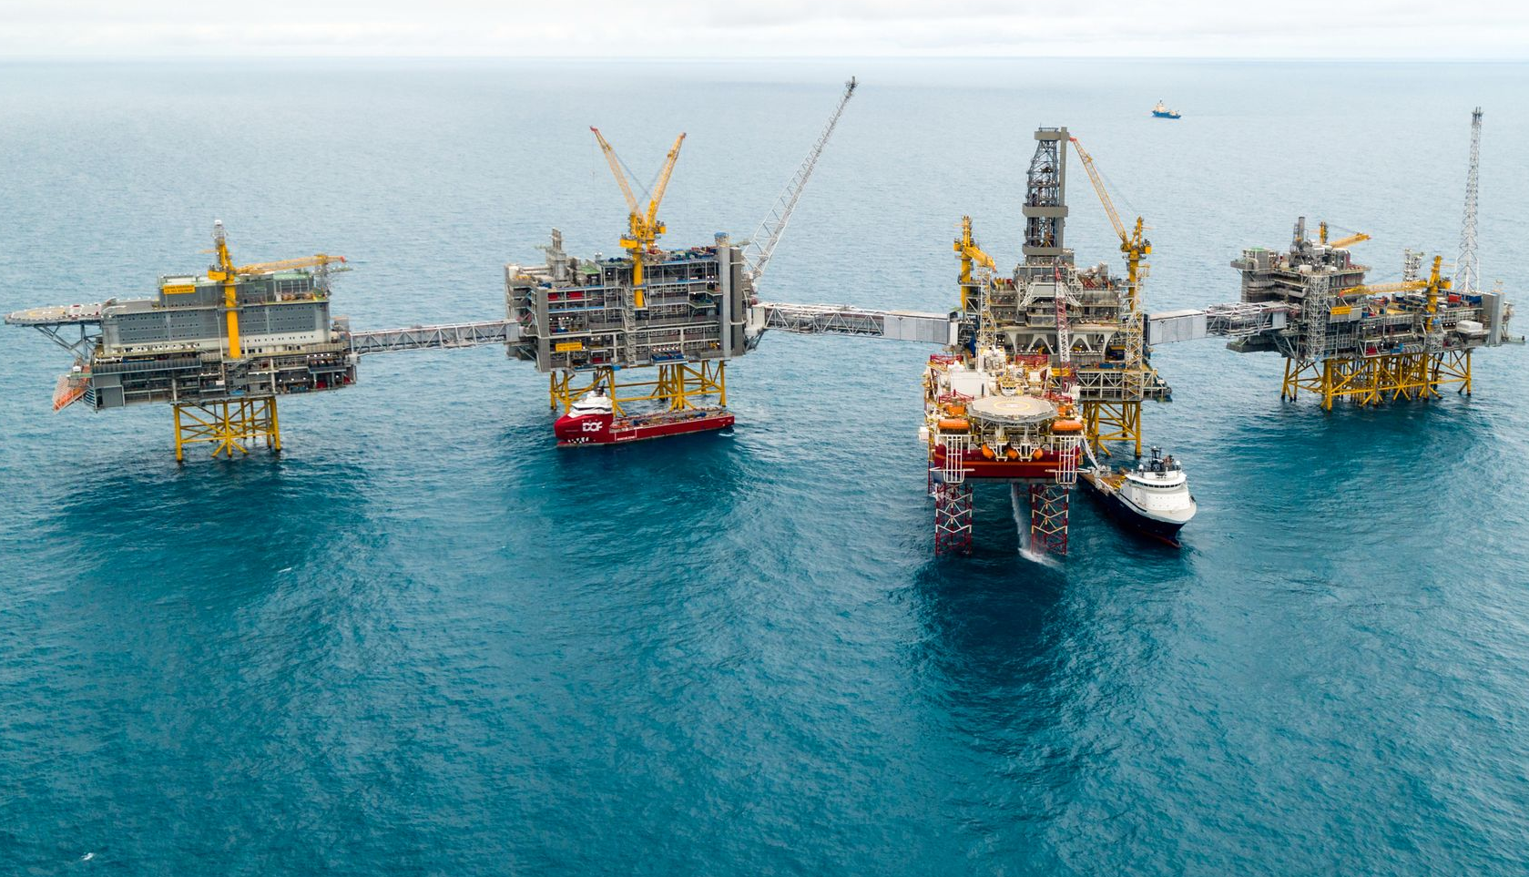
Tax proposals for maintaining activity in the oil and gas industry
Version 4 April 2020

Slide 2
Rystad Energy outlines three scenarios

Slide 3
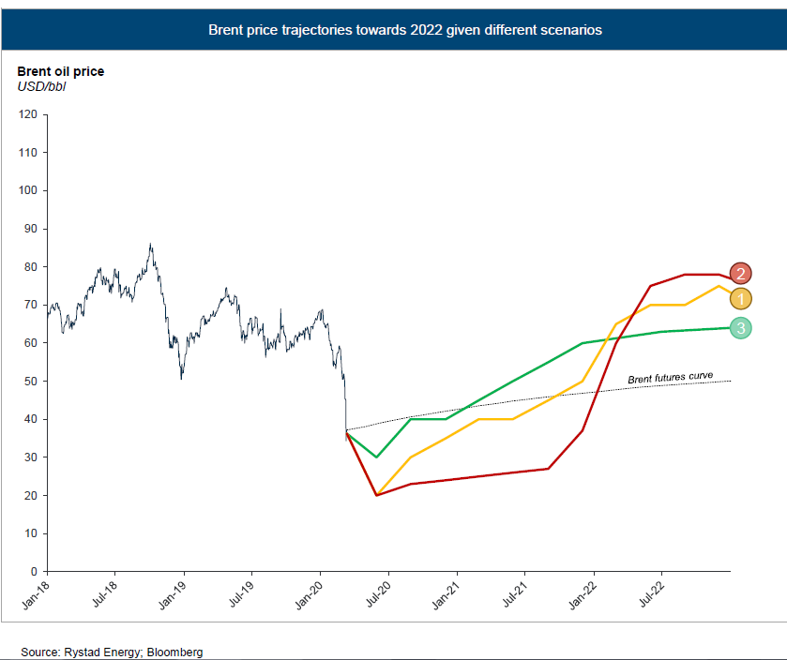
All of them expect oil prices to stay below USD 40/bbl until January 2021

Slide 4

Scenario 1 –
Effective measures
Main scenario
Median oil prices in the short term
As demand rises, Opec+ will have incentives to resume price collaboration
This scenario envisages agreement on production cuts from June 2020

Slide 5
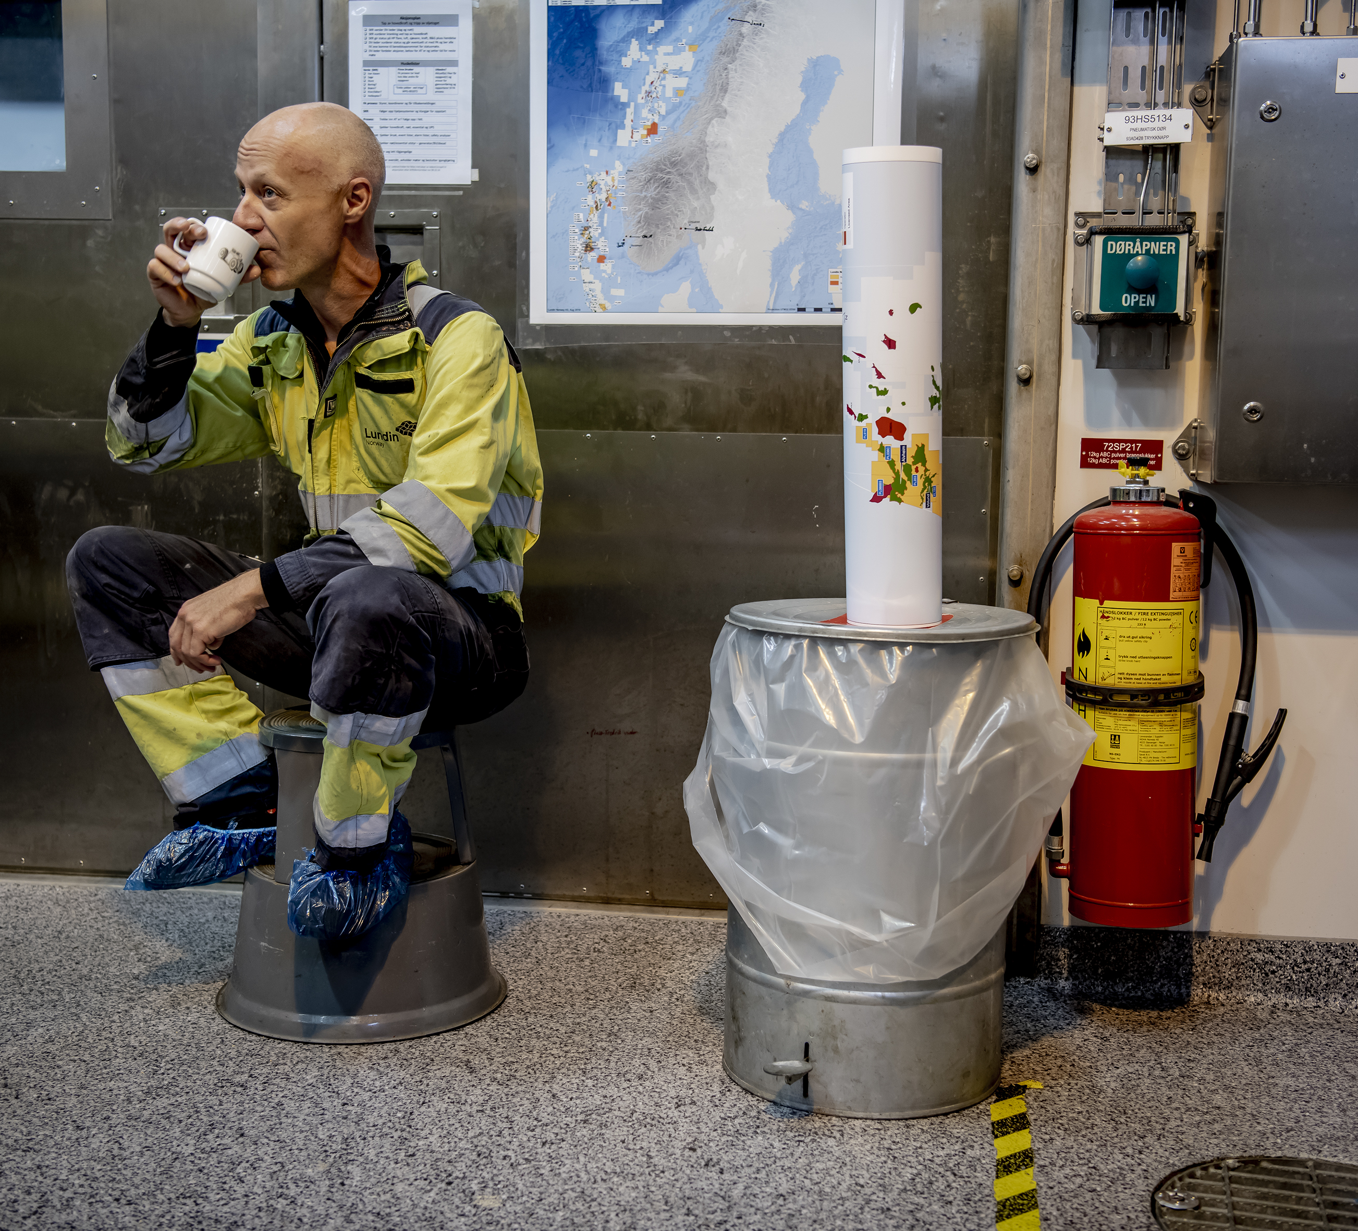
Scenario 2 – Manage the virus
Low oil prices in the short term
Low demand will give low oil prices in any event
Opec+ lacks sufficiently strong incentives to collaborate on price in this scenario

Slide 6
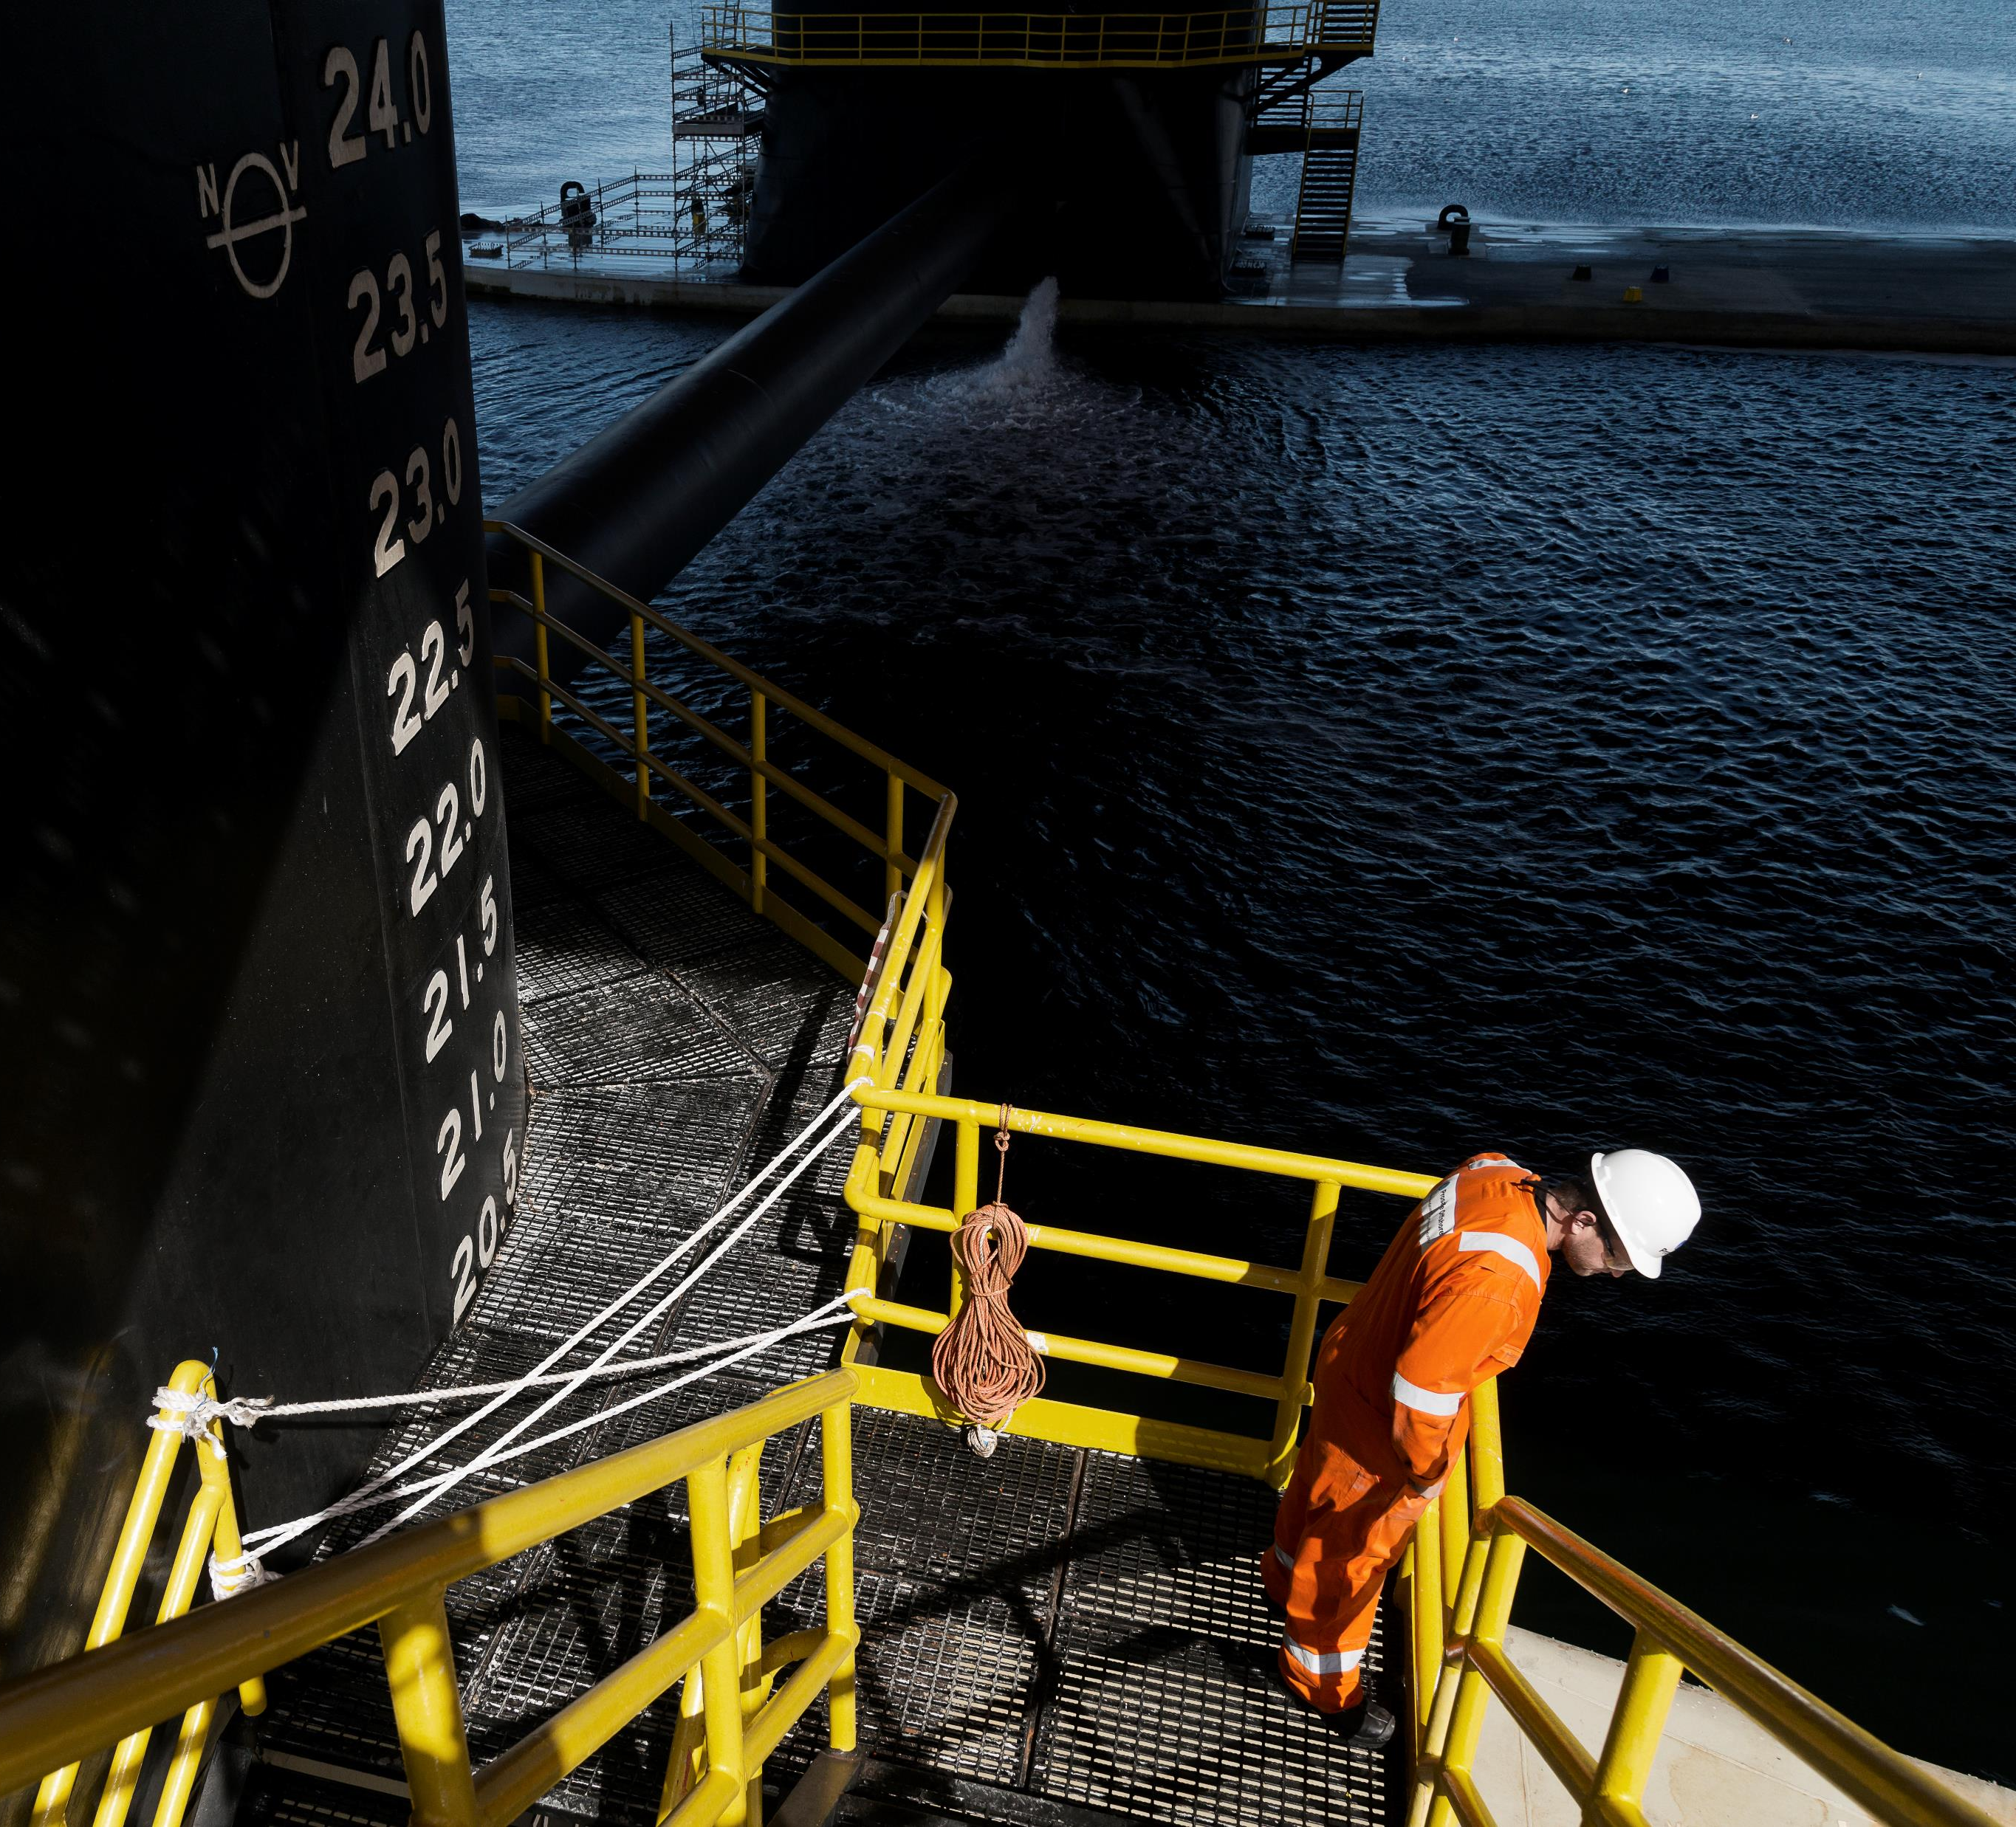
Scenario 3 – Negligence
Highest oil prices in the short term
A more "normal" economy provides incentives for price collaboration
Once again assumes production cuts among Opec+ in June 2020

Slide 7
This will affect investment on the Norwegian continental shelf (NCS)

Slide 8
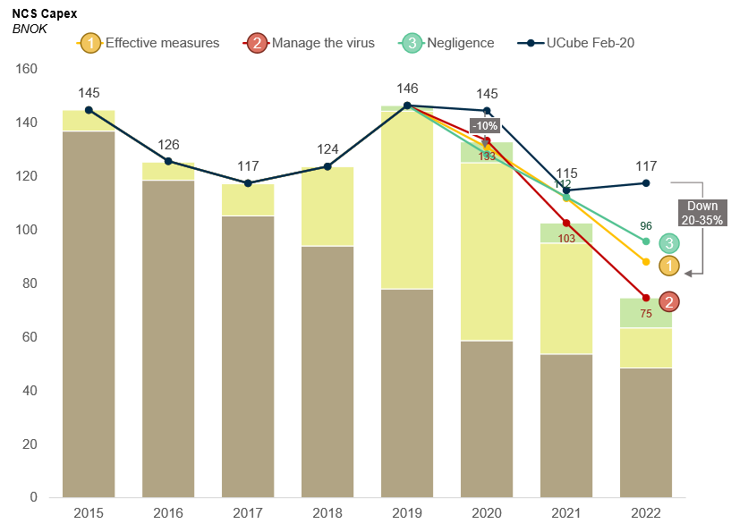
Oil prices and the coronavirus
Level of investment reduced mainly because of lower oil prices, but also because of pandemic effects
10 per cent reduction this year compared with the February estimate measured in Norwegian kroner
20-35 per cent estimated reduction in 2022
Notes:
Investeringsnivået tar utgangspunkt i hovedscenario for oljepris.
Målt i norske kroner.
*CAPEX includes upstream facility capex, well capex as well as capex for infrastructure owned by licenses (abondonment cost and land facilities are not included) Source: Rystand Energy research and analysis

Slide 9
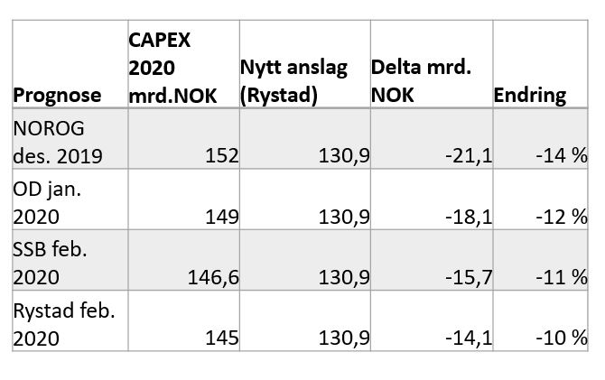
Pre-coronavirus estimates
Investment reduction affected by pre-coronavirus estimates
Depending on variations in “pre-virus” estimates, investment could fall by NOK 21-14 billion in 2020
The main explanation for the various “pre-virus” estimate levels is different assumptions on progress for non-sanctioned projects
Notes:
Dersom vi legger til grunn at nytt investeringsnivå i 2020 blir 130,9 mrd. NOK vil fallet krone for krone variere avhengig av "pre-korona" anslag
Reduksjonen Rystad skisserer skyldes utsetting/kansellering av ikke-sanksjonerte prosjekter, forsinkelser i leveranser fra verft, og færre infill-brønner på produserende felt.

Slide 10
Four tax proposals

Slide 11
Proposal – expensing new investments
Direct expensing (including uplift) of investment in 2020/2021
  Strong incentive to implement planned activity in the short term
  Investment and uplift are discounted by the risk-free interest rate* in order to be neutral
Direct expensing (including uplift) of investment following decisions sanctioned before 31 December 2021
  Strong incentive to implement planned activity in the short term and not put new projects on hold
  Investment and uplift are discounted by the risk-free interest rate* in order to be neutral
Direct expensing (including uplift) of investment made in accordance with PDO/PIO submitted before 31 December 2022
  Strong incentive to implement planned activity (such as preliminary studies) in the short term
  Strong incentive to generate new activity related to submission/approval of new PDO/PIO between, for example, 1 April 2020 and 31 December 2022
  Investment and uplift are discounted by the risk-free interest rate* in order to be neutral for the state
Companies not in a tax position can request temporary payment of losses incurred in 2020-24
  Carried forward today at the risk-free interest rate*, so paying out the loss is therefore neutral for the state
* For the risk-free interest rate, it is natural to use the same interest rate used for carrying losses forward – in other words, 12-month Treasury bills less 22 per cent tax. The interest rate for carrying losses forward also includes a supplement of 0.5
per cent (before tax), but it is not appropriate to include this in the discount rate. Excluding this supplement, the interest rate for 2019 would have been 0.9 per cent. Today it would have been about 0.1 per cent.

Slide 12
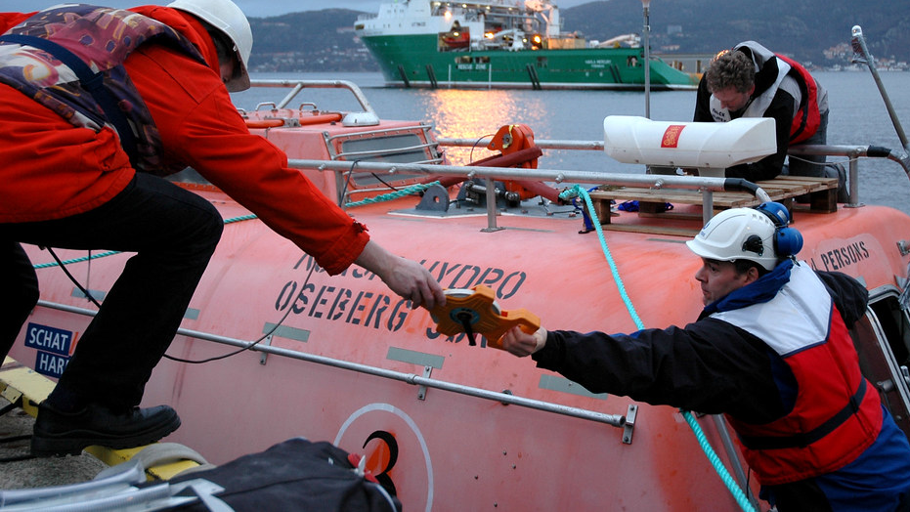
The government covers about 90 per cent of all NCS investment
By allowing the companies to depreciate investment over six years
The companies must finance the government’s share through loans or equity

Slide 13
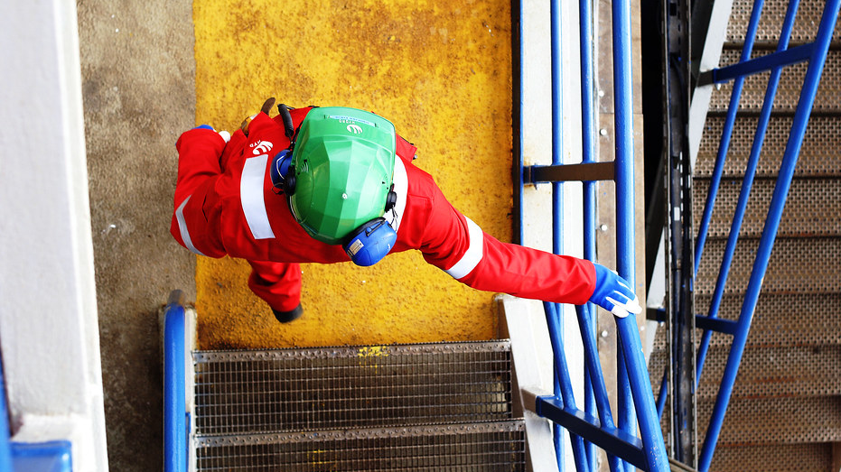
The proposal involves no change to the share covered by the State
The oil companies pay the same amount of tax, but at a different time
Instead of waiting for six years to secure the tax allowance, the companies receive it in the same year that the investment is made
The companies must finance the government’s share for a shorter period than today
Big significance when finance is both difficult and very expensive to access

Slide 14
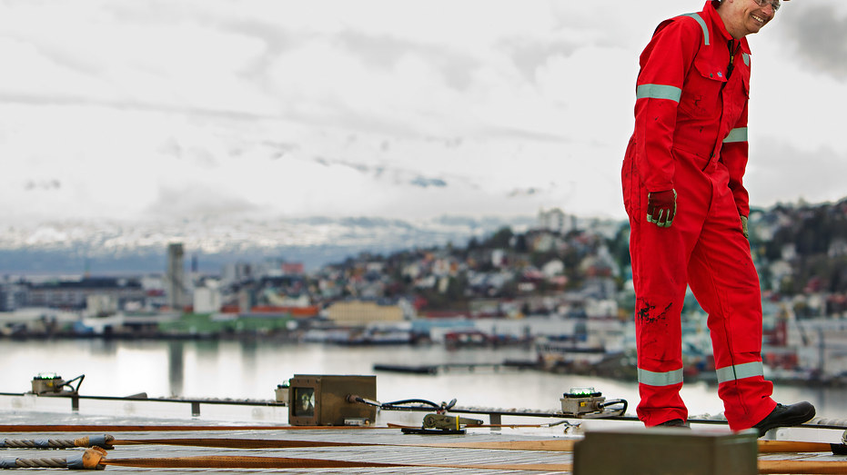
The proposal costs the state nothing in lost tax
No tax relief
The state’s “loss” from giving a tax allowance at once, rather than over six years, is met by the companies through lower allowances
The allowances are reduced by the state’s own borrowing rate (12-month Treasury bills). NOK 1 is worth more today than in six years time.
The state’s tax revenues will increase because the companies get lower financing costs = reduced tax deduction for interest payments

Slide 15
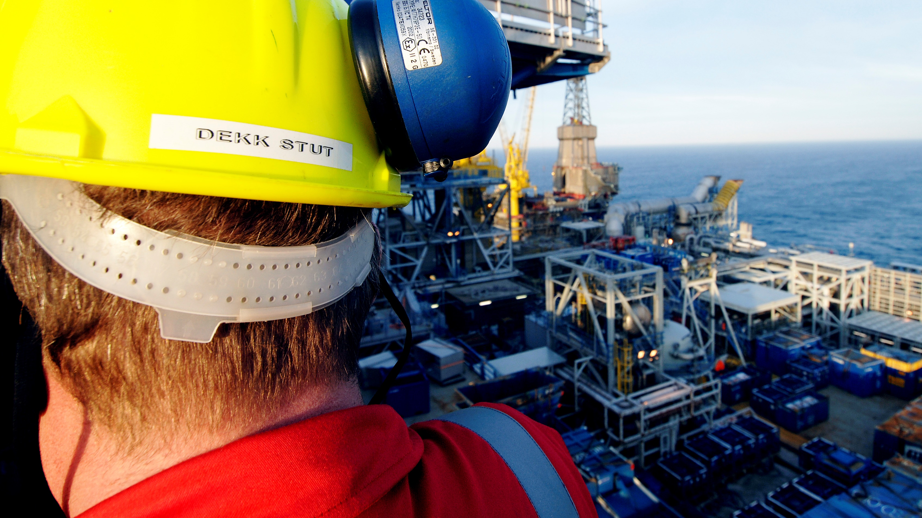
The proposal is temporary
Applies to investment made in 2020 and 2021
Applies to investment made after 2021, providing it is made in accordance with decisions taken before 31 December in 2021 or 2022

Slide 16
The proposal will therefore increase activity

Slide 17
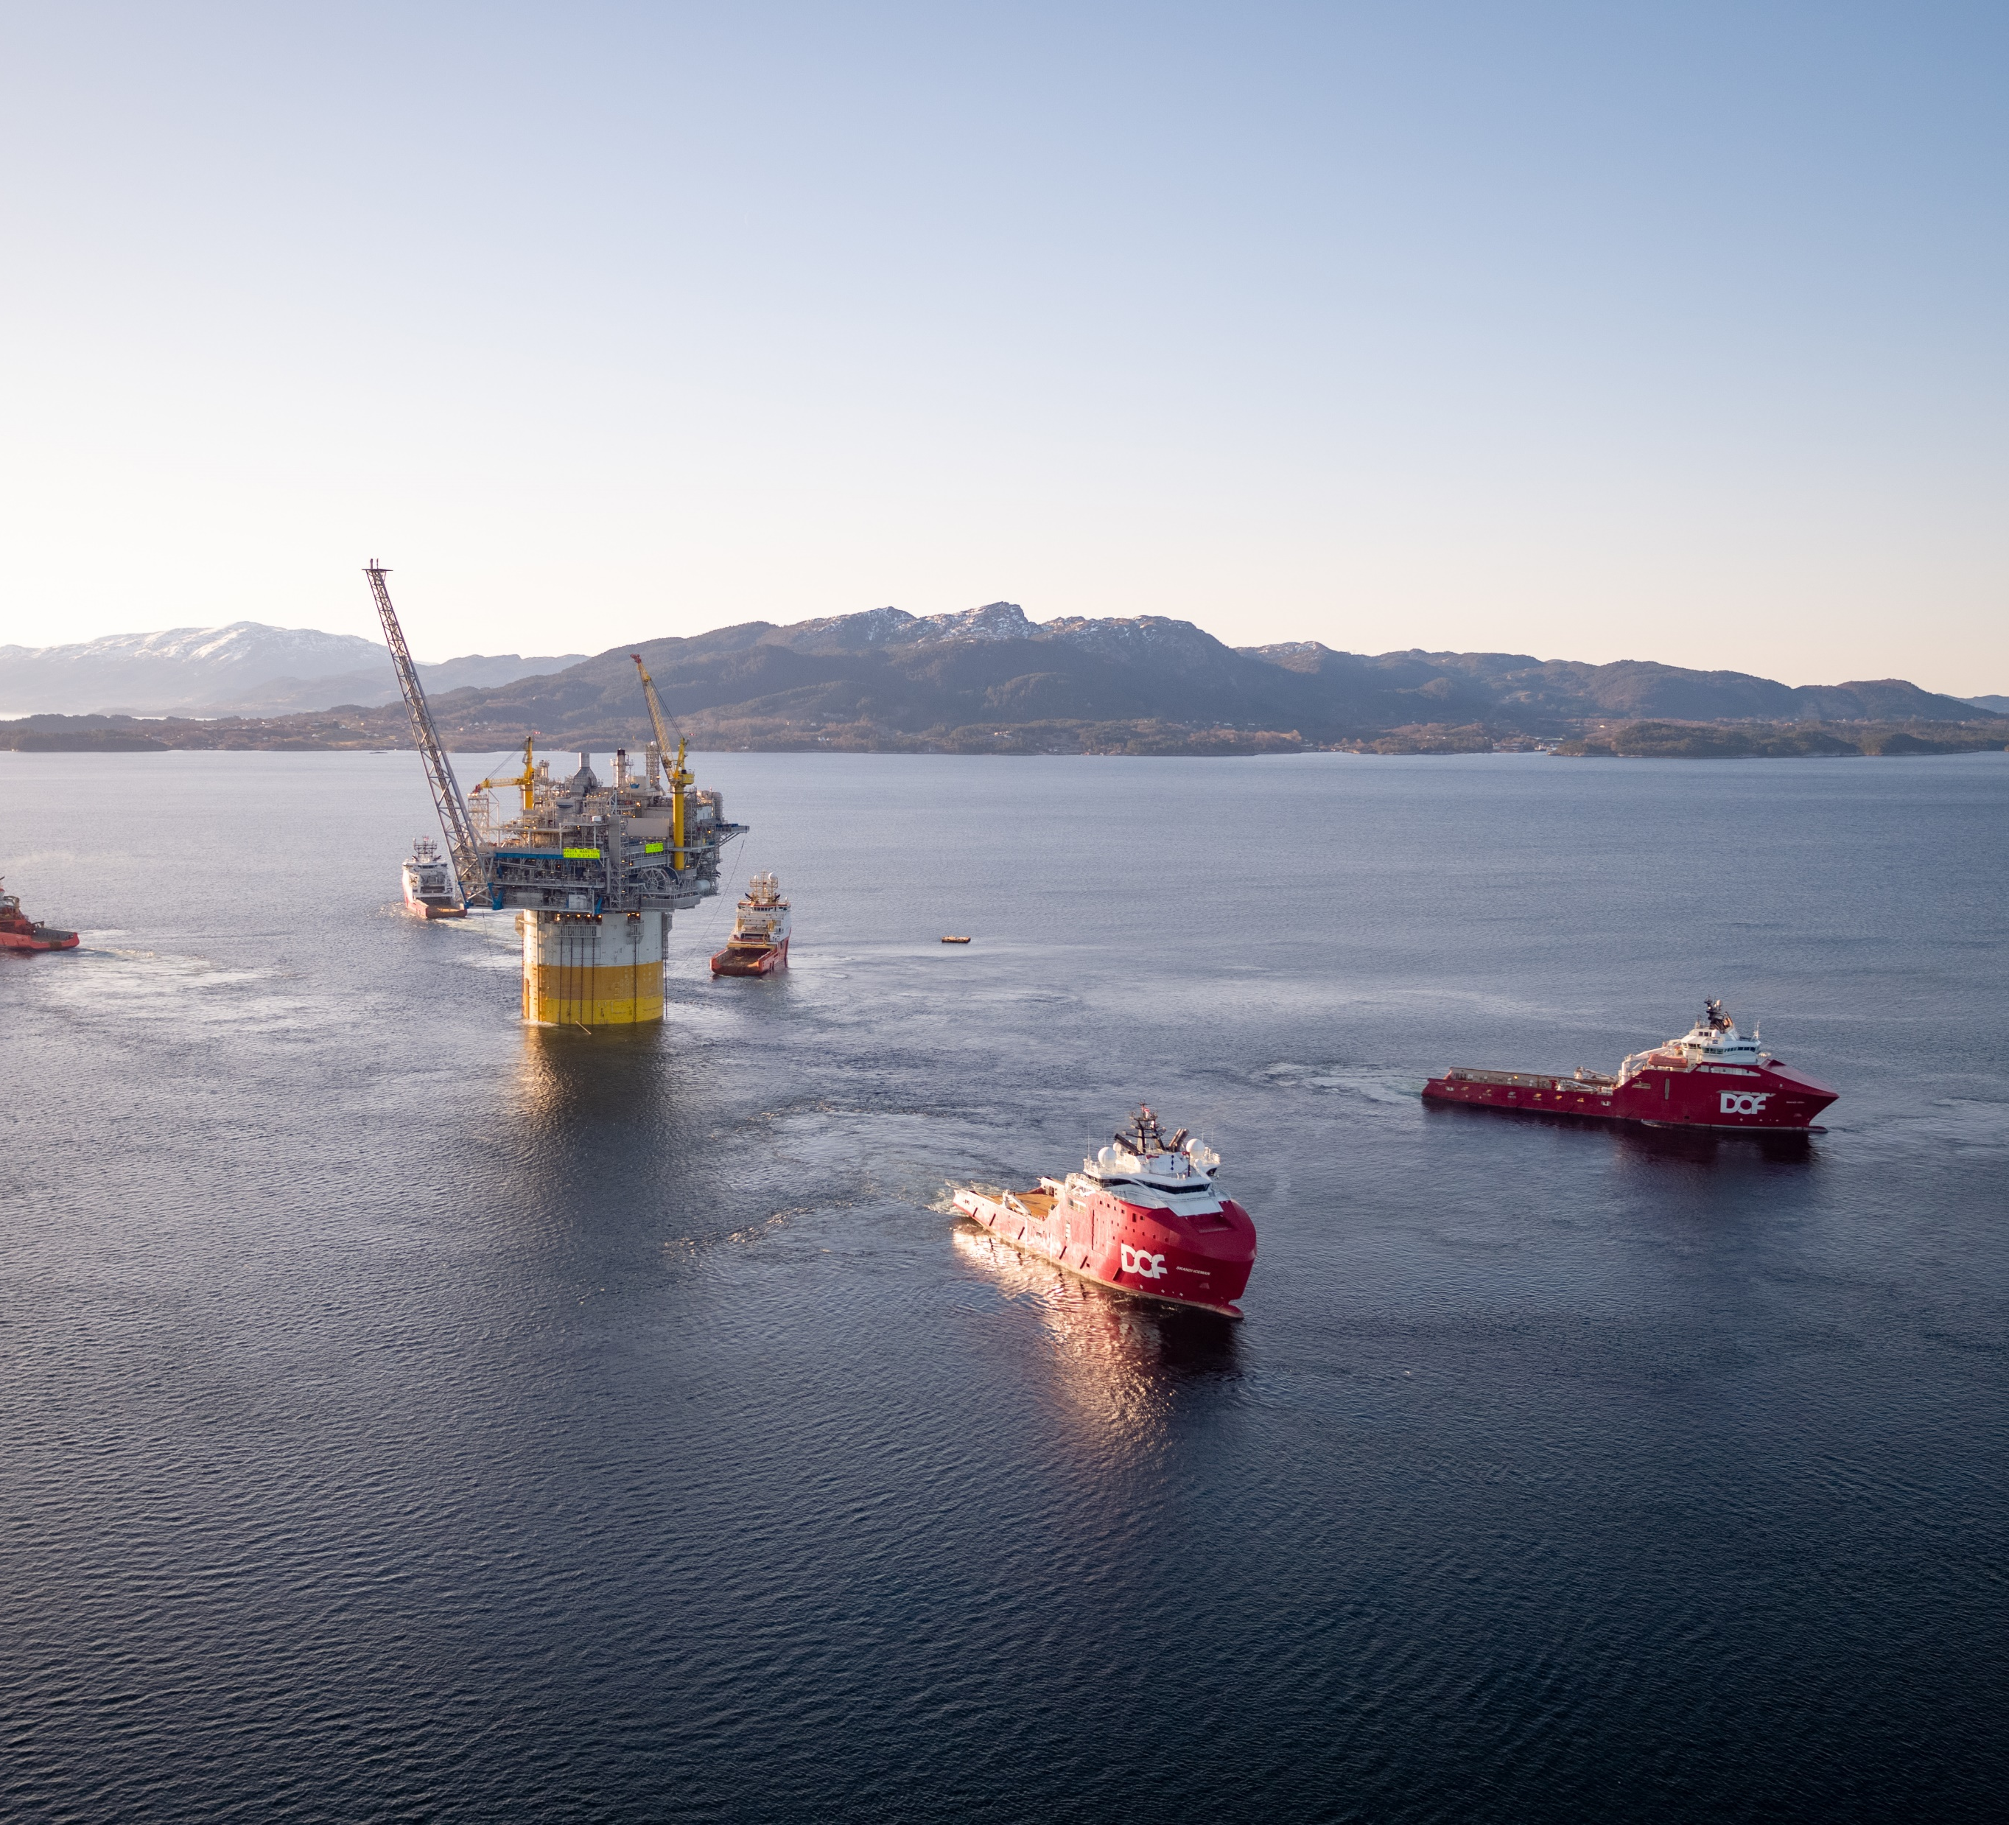
More investments become profitable
Significant reduction in financing costs related to the state’s 90 per cent share
More realistic to secure finance for investment when the 90 per cent state share is returned much faster
The present value (company assessment of profitability) of projects will be significantly strengthened, and will offset part of the oil price slump

Slide 18
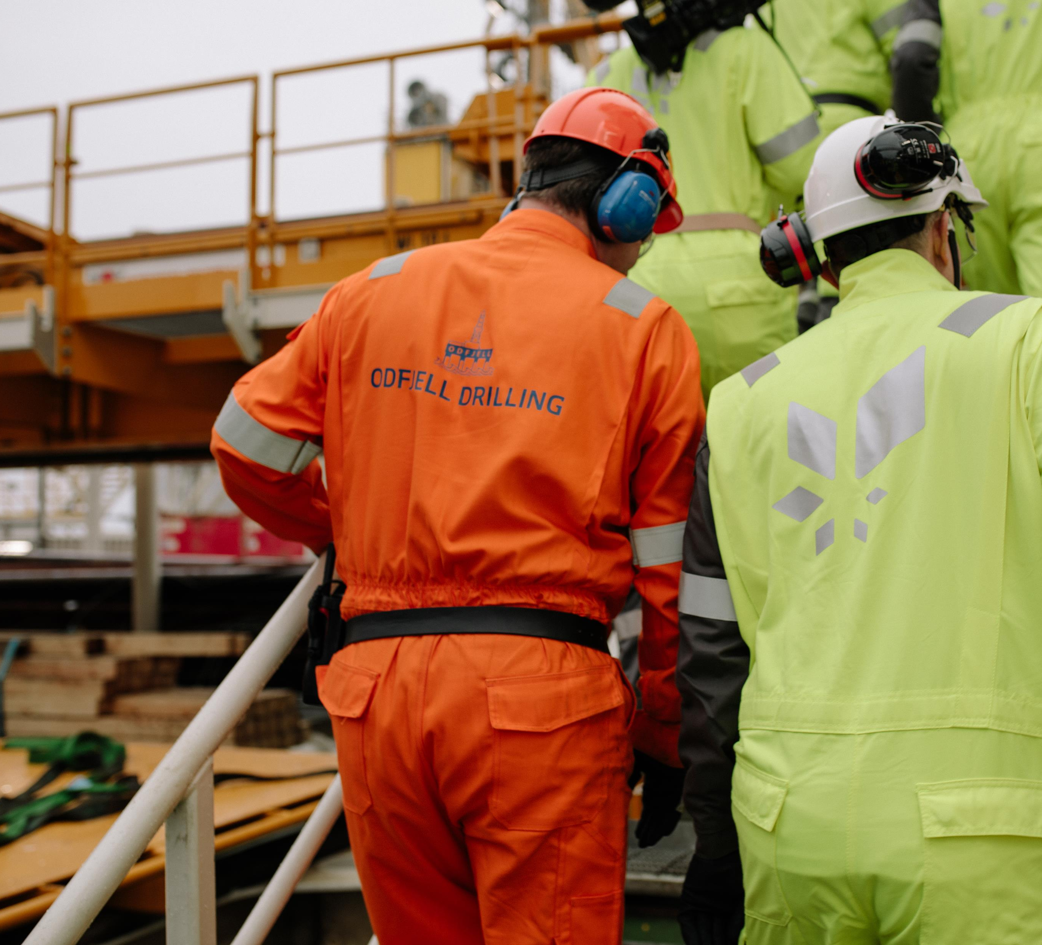
Gives increased activity and more jobs
Temporary proposal which incentivises investment in 2020-21
Ensures that today’s level of activity is maintained, avoids cuts in planned work and reduces redundancies and lay-offs
Incentivises further investment in 2020-21 to take advantage of the scheme
Covers investment after 2021 if decisions and actions specified in greater detail are taken before 31 December 2022
Strongly incentivises continued planning of new investment in a phase when such work would otherwise have stopped.
New projects also secure employment in the medium term (two-five years)

Slide 19
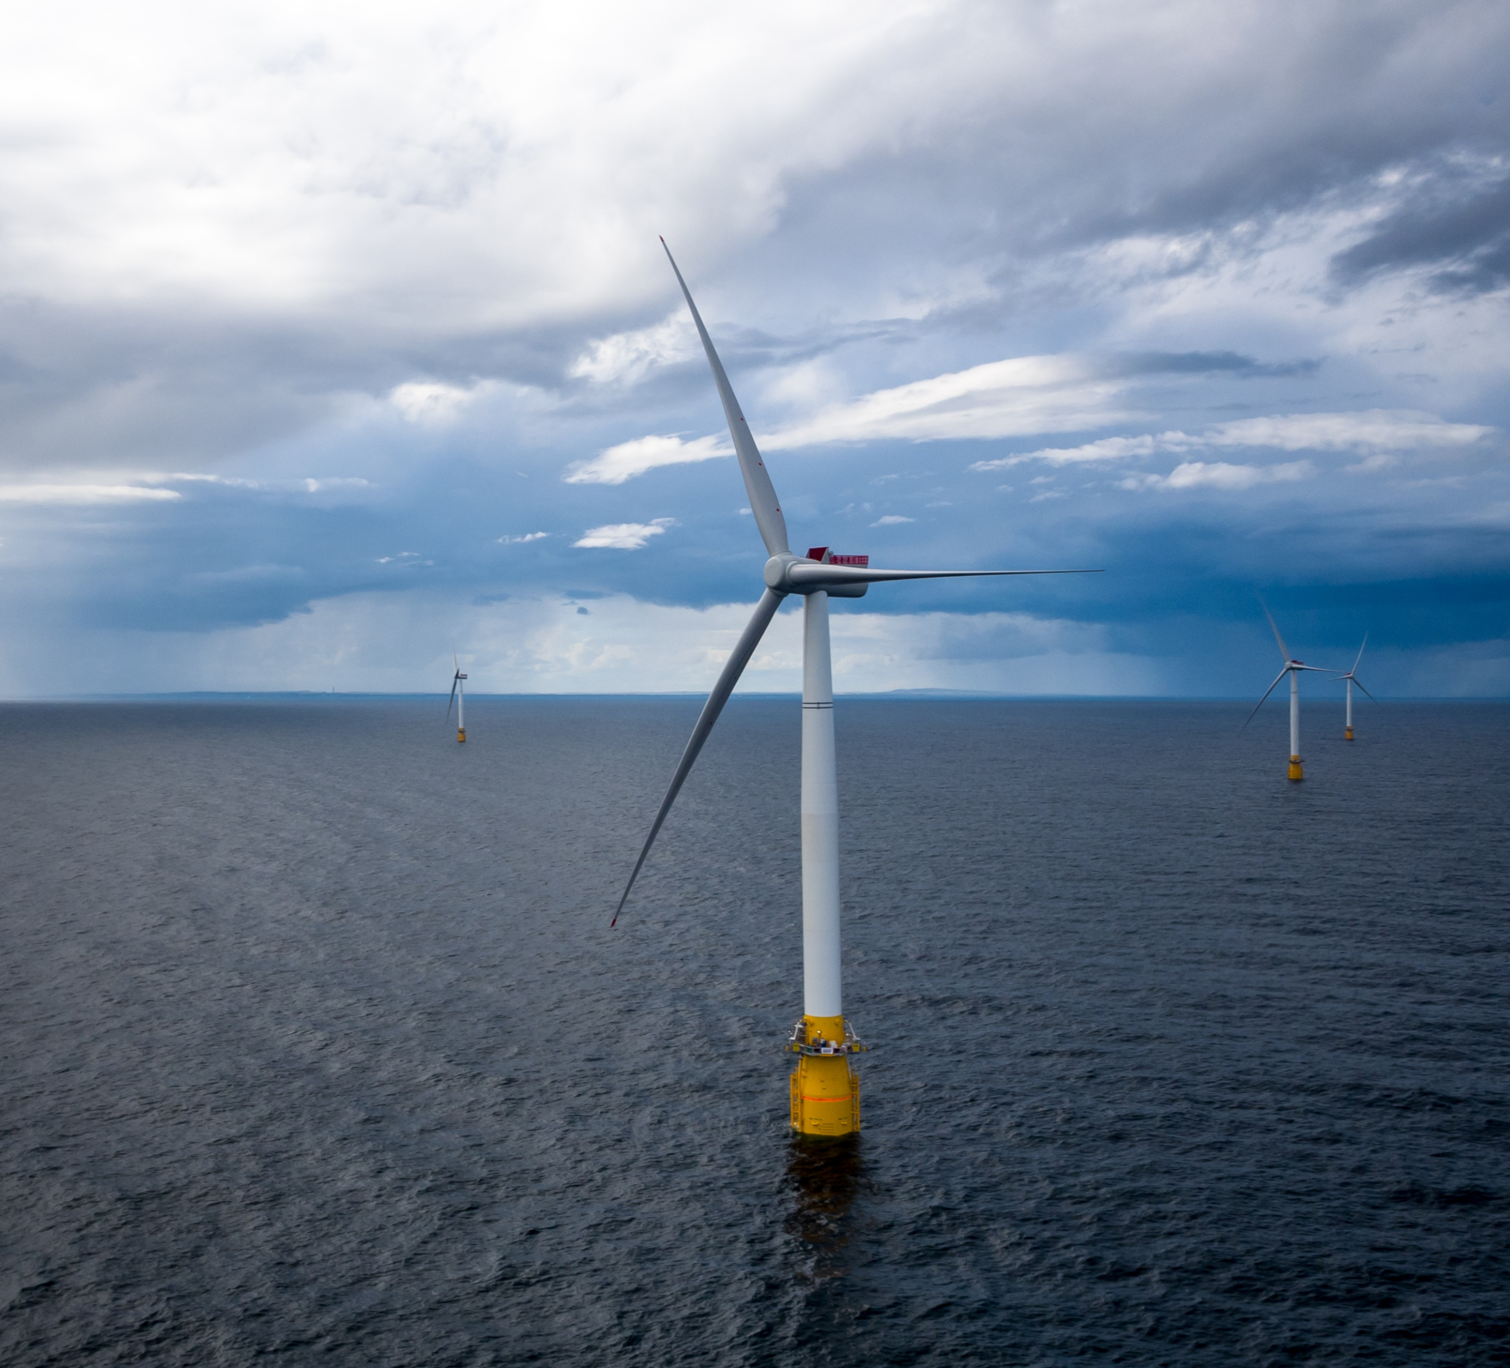
Preserves and develops expertise and technology in the supplier sector
Important with an eye to prudent action by the oil and gas industry, including future cessations and removals
Important for developing and installing carbon capture facilities, offshore wind power and other green energy

